Slide 1
Artificial Intelligence and Machine Learning
22CS015
Submitted by:
Dhruv Sehgal (2210990277)
Devansh Mittal (2210990260)
Dhruv Kinger (2210990275)
Devang Saini (2210990257)
Submitted to:
Mr. Tushar Khitoliya
Department of Computer Science and Engineering
Chitkara University, Punjab

Slide 2
About
Heart Disease Detection using Machine Learning
What is Machine Learning: Machine learning is a field of artificial intelligence focused on developing algorithms that can learn from data without explicit programming. Imagine a computer program that improves at a task, like recognizing faces in photos, the more examples it sees. Machine learning algorithms do this by analyzing data, identifying patterns, and making predictions based on those patterns. It's like teaching a computer to learn from experience.
Use of Machine Learning in Healthcare System: Machine learning is playing a growing role in healthcare. By analyzing vast amounts of patient data, algorithms can spot hidden patterns and predict risks for diseases, recommend treatment options, and even help with drug discovery. This can improve accuracy in diagnosis, personalize treatment plans, and potentially lead to earlier interventions and better patient outcomes.

Slide 3
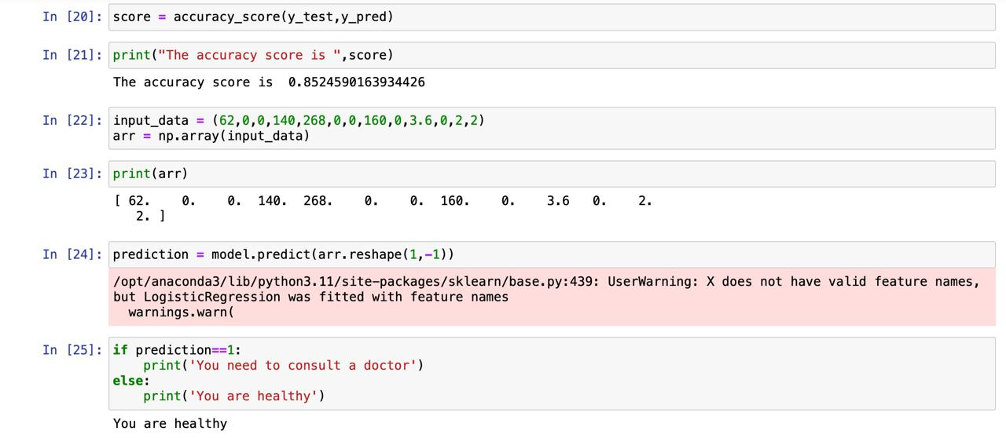
Machine learning can analyze a patient's medical history, test results, and lifestyle habits to identify patterns linked to heart disease. These patterns can help predict a person's risk of developing the condition. By analyzing vast amounts of data, machine learning can potentially identify hidden risk factors and even suggest preventive measures.

Slide 4
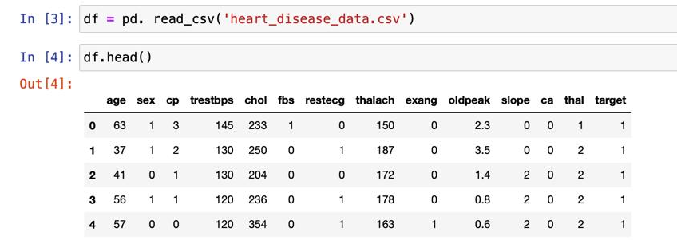
Key Functionalities
Data Exploration and Preprocessing: Examining and cleaning patient data to prepare
it for machine learning algorithms.
Model Training: Training a machine learning model (e.g., logistic regression) on the
data to learn the relationship between patient features and heart disease.
Prediction on New Data: Using the trained model to predict the likelihood of heart
disease for new patients based on their characteristics.

Slide 5
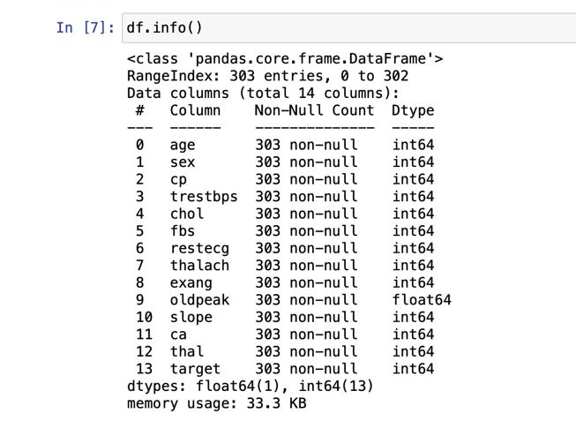
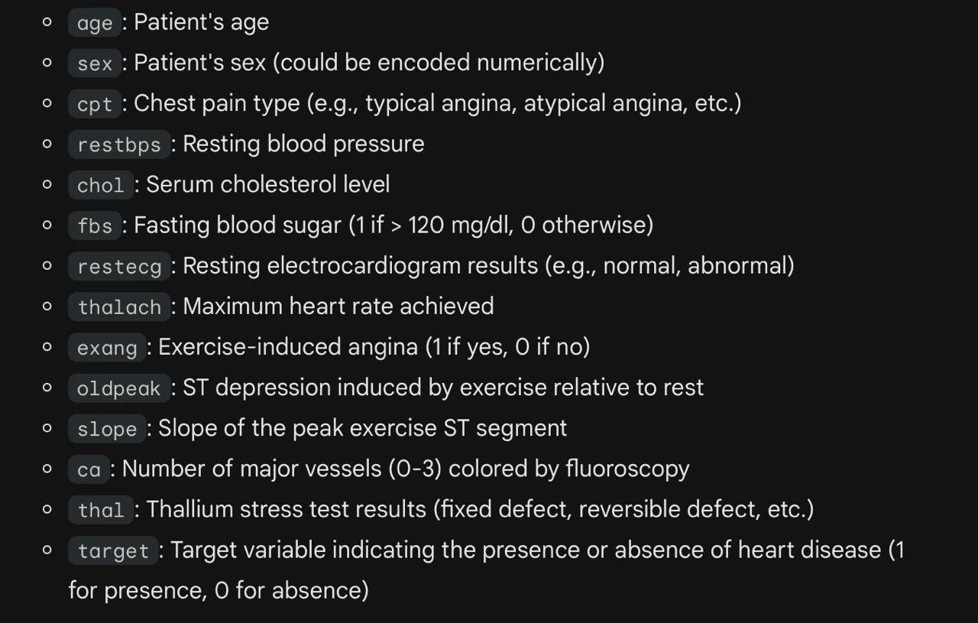
Data Acquisition
The specific dataset we used from Kaggle for this project contains information about patients and their heart disease status. It includes:
Patient Characteristics: Features like age, gender, blood pressure, cholesterol levels, blood sugar levels, chest pain type, thallium stress test, etc.
Medical History: Information about previous diagnoses or procedures related to heart disease.
Target Variable: An indicator variable denoting the presence (positive) or absence (negative) of heart disease in the patient.
This dataset provides the foundation for training a machine learning model to identify patterns between patient characteristics and heart disease risk.

Slide 6
Data Preprocessing
Data preprocessing is the initial step in preparing raw data for use in machine learning algorithms. It's like cleaning and organizing your ingredients before you start cooking.
Here's why it's important:
Improves Data Quality: Preprocessing helps address issues like missing values, inconsistencies, and errors in the data. This ensures the model is trained on high-quality information.
Enhances Model Performance: Clean and structured data allows the machine learning algorithm to learn more effectively from the patterns and relationships within the data. This can lead to better predictions and more accurate results.
Ensures Efficiency: Preprocessed data is easier for the algorithm to process, reducing training time and computational resources needed.

Slide 7
Model Building
Logistic Regression for Heart Disease Prediction
Logistic regression is a machine learning algorithm commonly used for classification problems where the target variable can have two or more discrete categories. In the case of heart disease prediction, the target variable is likely binary: presence (positive) or absence (negative) of heart disease.
How logistic regression works for classification:
Model with Sigmoid Function: Logistic regression builds a mathematical model that takes patient features (age, blood pressure, etc.) as input and uses a special function called the sigmoid function to output a probability value between 0 and 1.
Learning from Data: During training, the model is presented with patient data points where features are linked to the actual presence or absence of heart disease. The model adjusts its internal coefficients (weights) to minimize the error between its predicted probabilities and the actual labels (positive or negative for heart disease).

Slide 8
Model Training
Splitting the Data: The dataset is divided into two parts: training data and testing data.
Training Data for Learning: The training data contains patient features and their corresponding labels (presence or absence of heart disease).
Logistic Regression Model: The algorithm builds a mathematical model using the features as input.
Predicted Probabilities: The model calculates a probability between 0 and 1 for each patient in the training data, indicating the likelihood of heart disease based on their features.
Error Calculation: The model compares its predicted probabilities to the actual labels (positive or negative for heart disease) in the training data. This calculates the error (difference) between predictions and reality.
Coefficient Adjustment: The model iteratively adjusts its internal coefficients (weights) for each feature to minimize the overall error.
Learning from Errors: By minimizing errors on the training data, the model learns the relationships between features and heart disease.
Stopping Criteria: The training process continues until a stopping criteria is met, such as a certain number of iterations or a sufficiently low error rate.

Slide 9
Prediction
Once trained on the data containing patient features and their corresponding heart disease labels, the logistic regression model can be used to predict the likelihood of heart disease for new patients. Here's how it works:
New Patient Data: Information about a new patient, including their characteristics (age, blood pressure, etc.), is fed into the model.
2. Probability Calculation: The model uses the trained weights (coefficients) and the new patient's features to calculate a probability value between 0 and 1.
3. Interpretation of Probability: This probability represents the estimated likelihood of the new patient having heart disease based on the model's analysis of their features and the patterns learned from the training data.

Slide 10
Conclusion
This presentation explored the potential of using machine learning, specifically logistic regression, to predict heart disease. We investigated a dataset containing patient information and their heart disease status.
Key Takeaways:
A logistic regression model was trained to identify patterns between patient features and the presence of heart disease.
The model's performance was evaluated using metrics to assess its ability to classify patients with and without heart disease.
The trained model can be used to predict the probability of heart disease for new patients based on their characteristics.

Slide 11
References
Geeks for Geeks: https://www.geeksforgeeks.org/ml-heart-disease-prediction-using-logistic-regression/
Youtube: https://www.youtube.com/watch?v=F_9gGyCs3YY

Slide 12
Thank You

